Slide 1

Using Efficient Local Fine-tuning Techniques to Extract Closure Information From Long National Park Comments
Austin Lackey

Slide 2
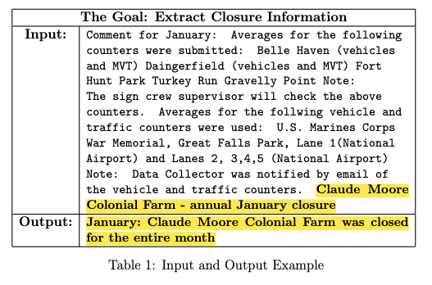
The Problem
400 Parks
12 Months of data
12x400=~4,000 comments

Slide 3
The Problem
400 Parks
12 Months of data
12x400=~4,000 comments

